Slide 1

CS 5/6110, Software Correctness Analysis, Spring 2023
Ganesh Gopalakrishnan
School of Computing
University of Utah
Salt Lake City, UT 84112

Slide 2
Lecture 13 : Dynamic Symbolic Execution (also known as “Concolic Execution” standing for Concrete + Symbolic Execution)
There is so much C codes out there
How to even make a dent in verifying them?
How do DSE or Concolic tools help?
An amazing success story in this area: KLEE – OSDI 2008
How do they compare with fuzzers (what are they?)
Mention about American Fuzzy Lop or AFL
Study by Dr. Peng Li (my former student) is very good – slides uploaded on Canvas
How does all of this apply to parallel computing
Say GPUs?
Test of Time Award Honorable Mention for Dr. Guodong Li (my former student) and me at FSE 2020
Work on PUG (2010) and work on GKLEE (2012) – Guodong was VERY foresightful to have keyed off KLEE in 4 years!
Dr. Guodong Li is with Google Research now, and Dr. Peng Li is with ByteDance Inc. now

Slide 3
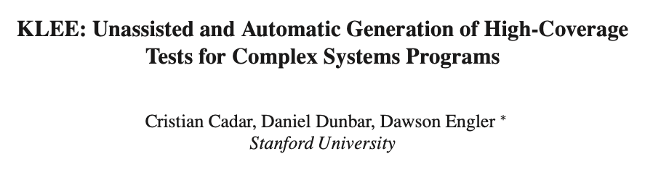

Slide 4
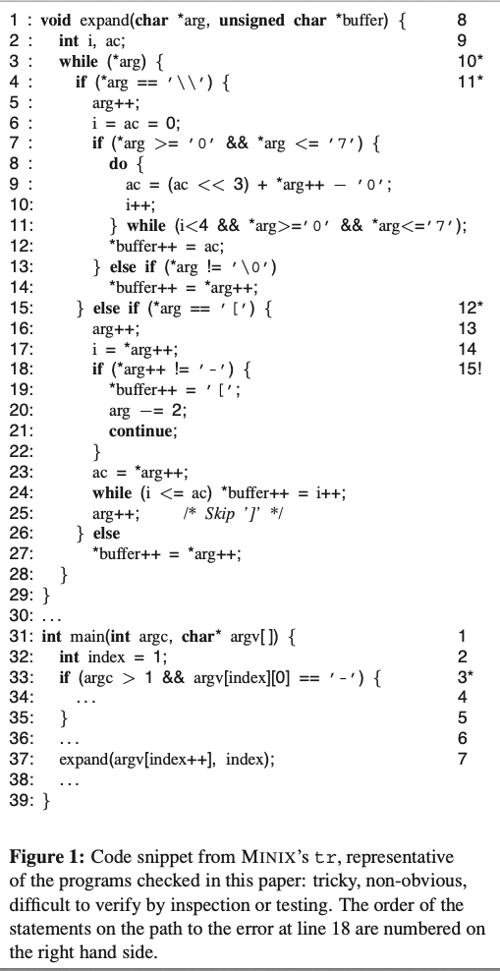
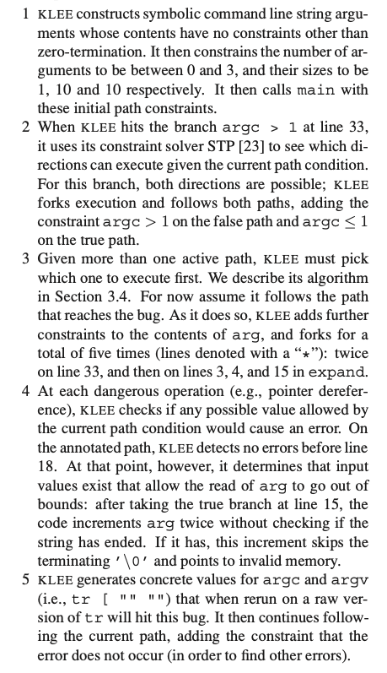
KLEE
OSDI
2008

Slide 5
Why can’t we crank through all inputs/states?
Your answer here for a C program that has exactly one 32-bit register
How about a 64-bit register?
Your answer here for a C program with 1k bytes of state and 64 bits of input
How about a C program with 5 threads with 5 sequential steps? How many interleavings?
How about something larger?

Slide 6
The main technology!
Progress in Boolean Satisfiability is central to the magic I’m going to demo
SAT-solving increased by 1000x or more (in performance)
SAT alone is not sufficient
SMT-solving was essential
Think of the SEND + MORE = MONEY problem!
Progress in SMT-solving happened this way
Nelson/Oppen methods of the 1980’s and Shostak’s method
SVC and CVC and Yices
Then Z3, and now CVC4 and a whole array of others!
Rides on the power of SAT-solving but their “theory-solving” is key
KLEE uses “STP”, an SMT solver that can handle bit-arrays and uninterpreted functions well
This is why we must study mathematical logic
took 1000s of years since Euclid, 170 years since Boole, 100 years since Shannon, and 120 years since Russell, Peano and others to get here!
in addition to all those other “cool topics” to which students are flocking these days!
(What are some of those?!)

Slide 7
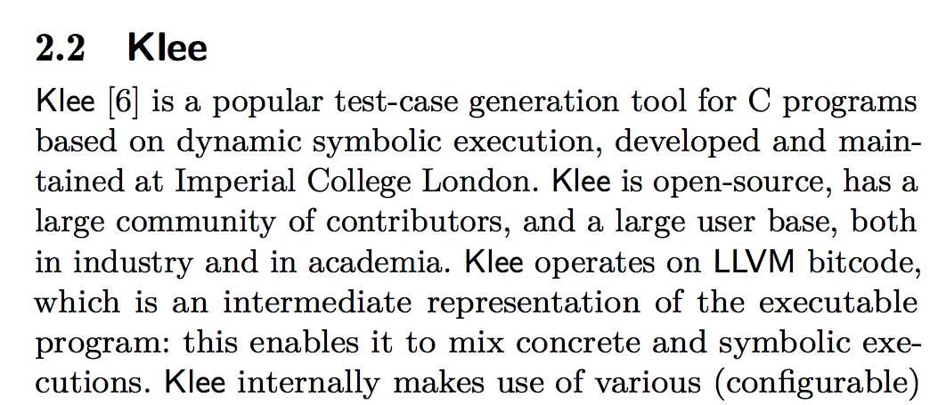
Publication on KLEE for enhancing its coverage
https://arxiv.org/pdf/2211.14592.pdf

Slide 8
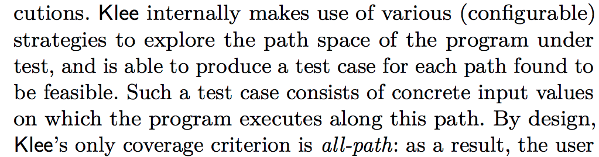
Publication on KLEE for enhancing its coverage
https://arxiv.org/pdf/2211.14592.pdf

Slide 9
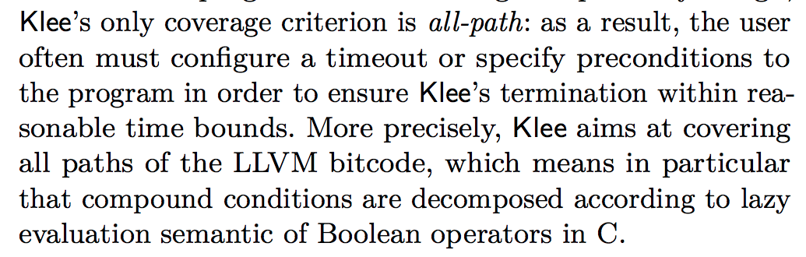
Publication on KLEE for enhancing its coverage
https://arxiv.org/pdf/2211.14592.pdf
The tutorial at https://adalogics.com/blog/symbolic-execution-with-klee
mentions that even a dozen lines of a Regexp code has about 7000 paths
This “path explosion” is an issue. But this also points to the futility of fuzzing such programs
(a point vividly brought out by Peng Li’s study)

Slide 10
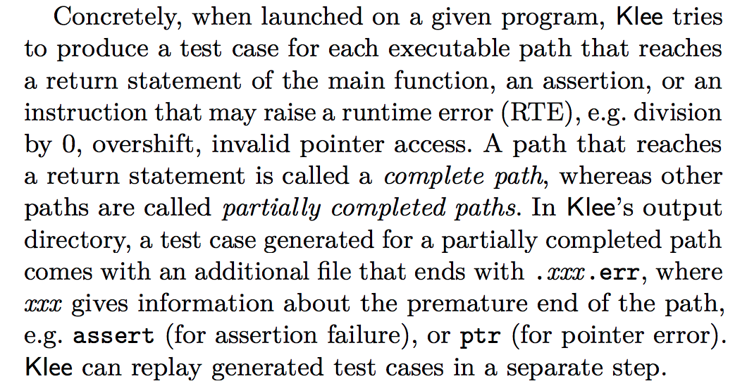
Publication on KLEE for enhancing its coverage
https://arxiv.org/pdf/2211.14592.pdf

Slide 11
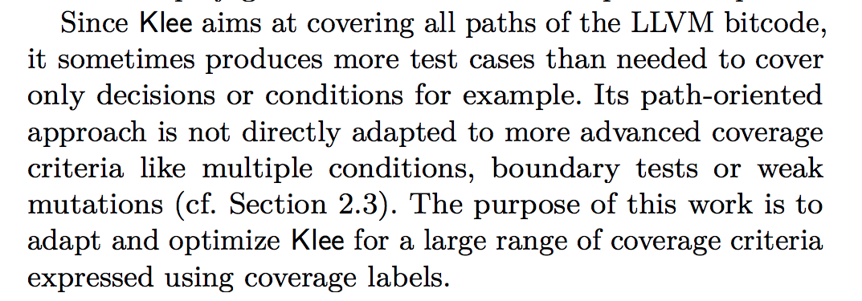
Publication on KLEE for enhancing its coverage
https://arxiv.org/pdf/2211.14592.pdf

Slide 12
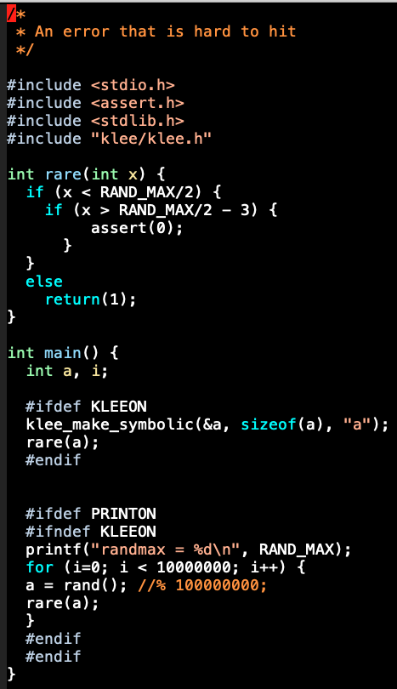
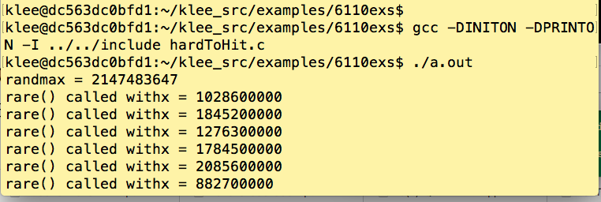
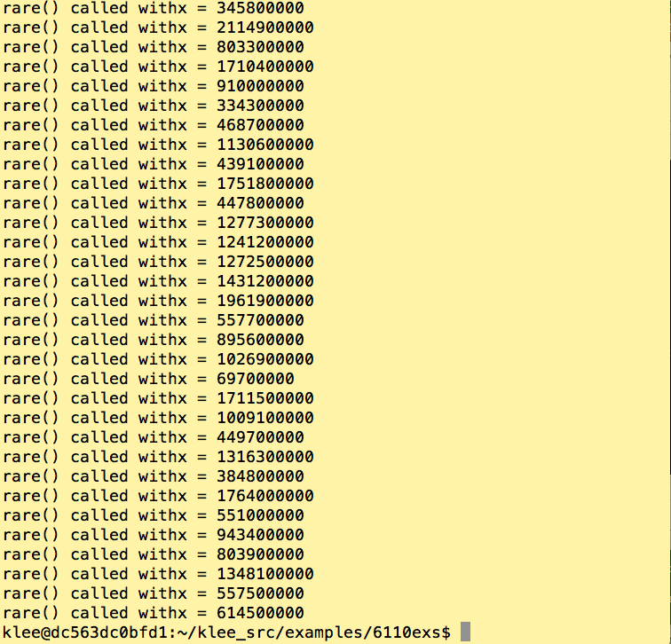
Demo-1 : a hard-to-test program under conventional testing and then KLEE

Slide 13
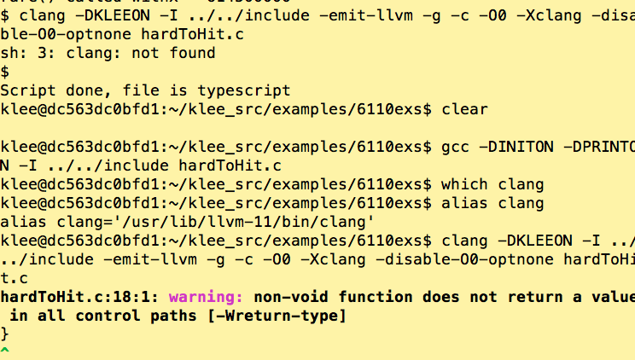
Demo-1 : a hard-to-test program under conventional testing and then KLEE

Slide 14
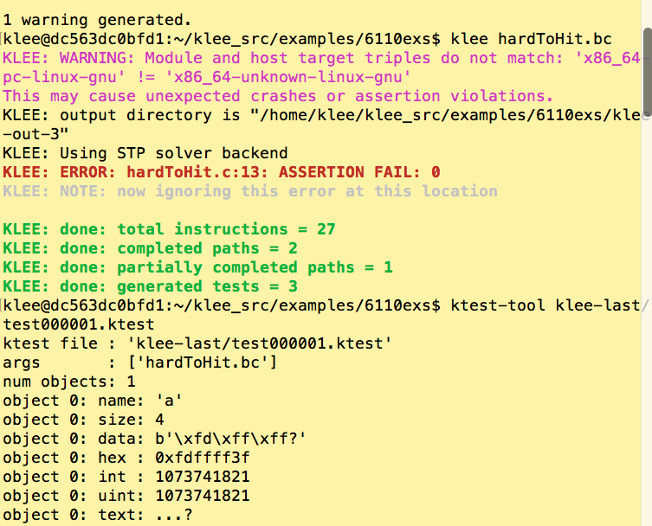
Demo-1 : a hard-to-test program under conventional testing and then KLEE

Slide 15
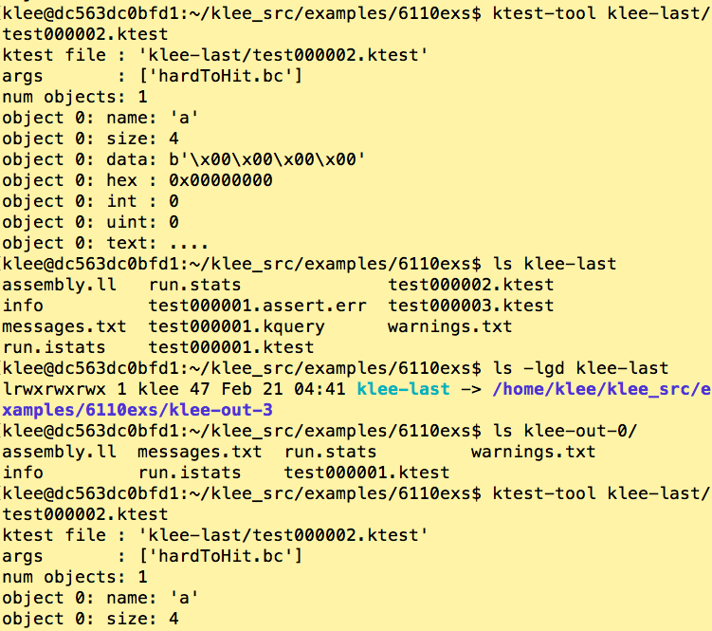
Demo-1 : a hard-to-test program under conventional testing and then KLEE

Slide 16
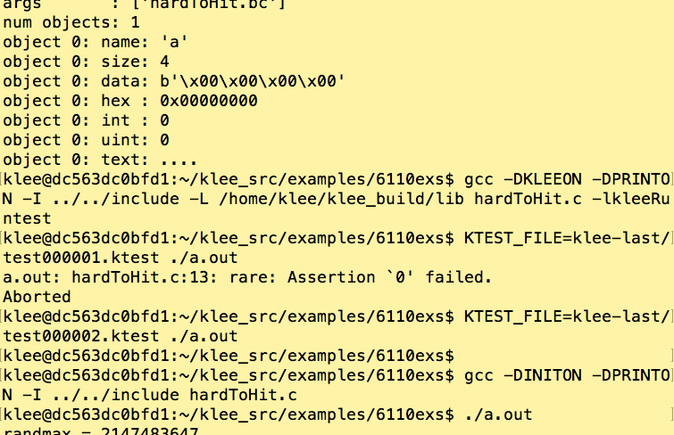
Demo-1 : a hard-to-test program under conventional testing and then KLEE

Slide 17
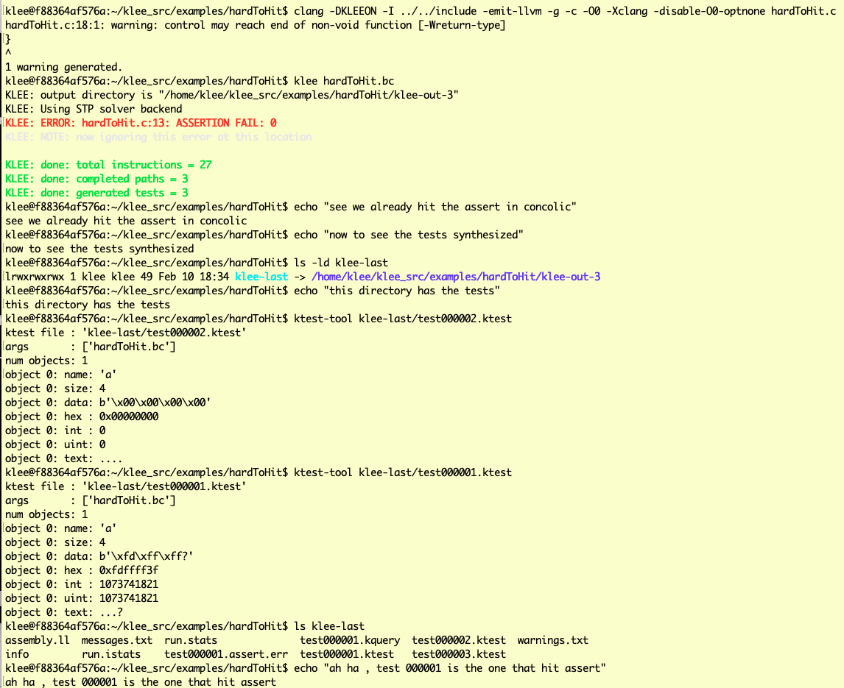
Enter KLEE !!

Slide 18
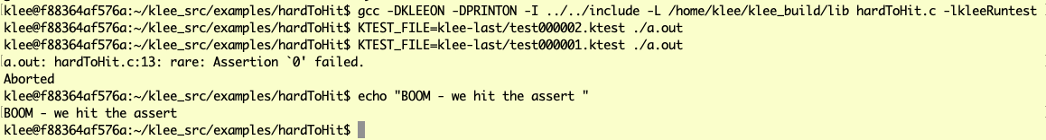
Enter KLEE !!

Slide 19
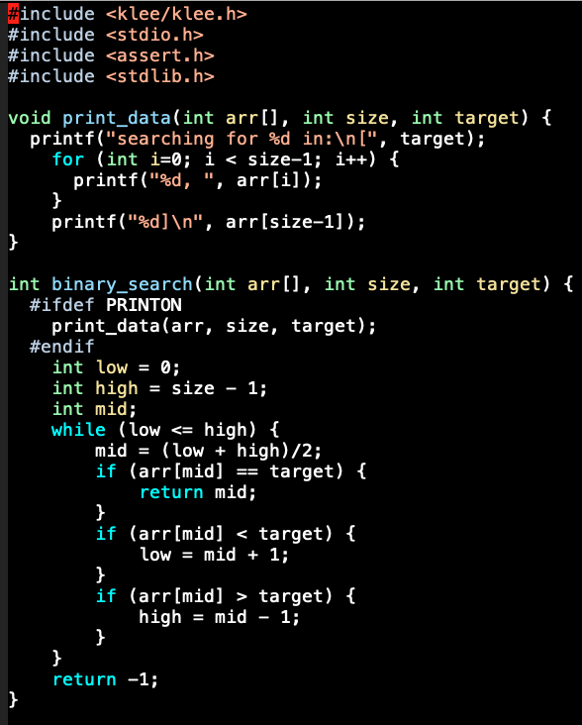
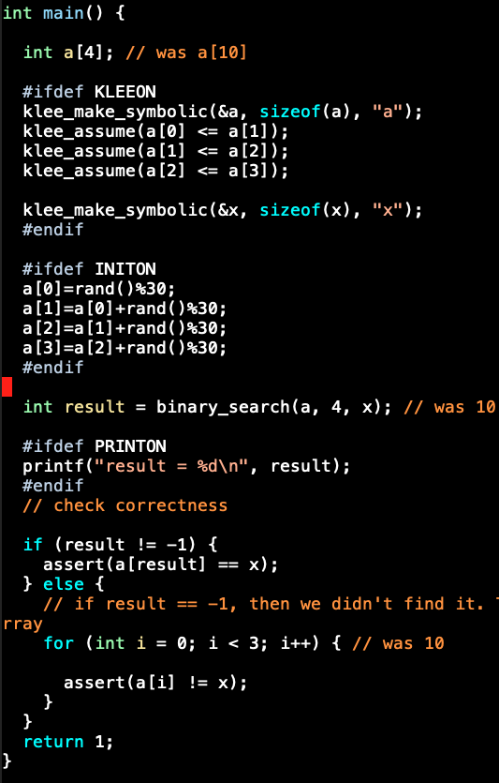
Demo-2 Binary Search Looks OK? Ship it?!

Slide 20
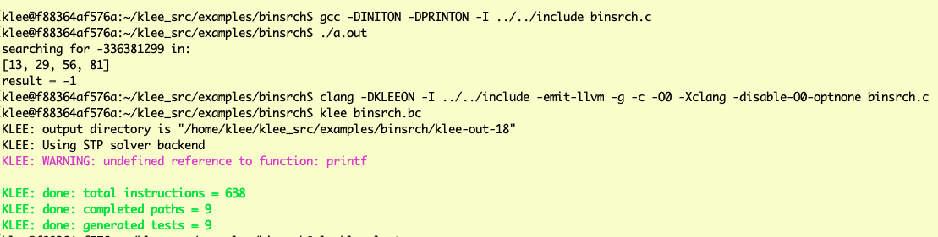
Demo-2 Binary Search Looks OK? Ship it?!

Slide 21
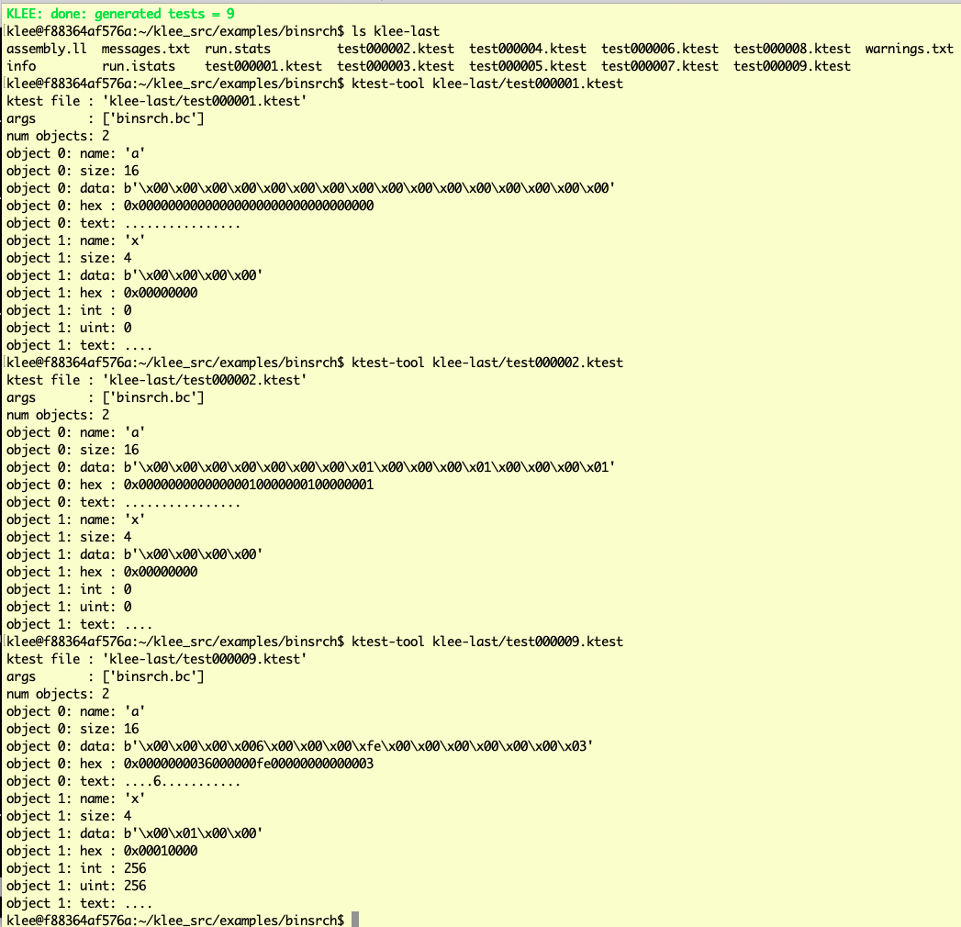
Demo-2 Binary Search Looks OK? Ship it?!

Slide 22
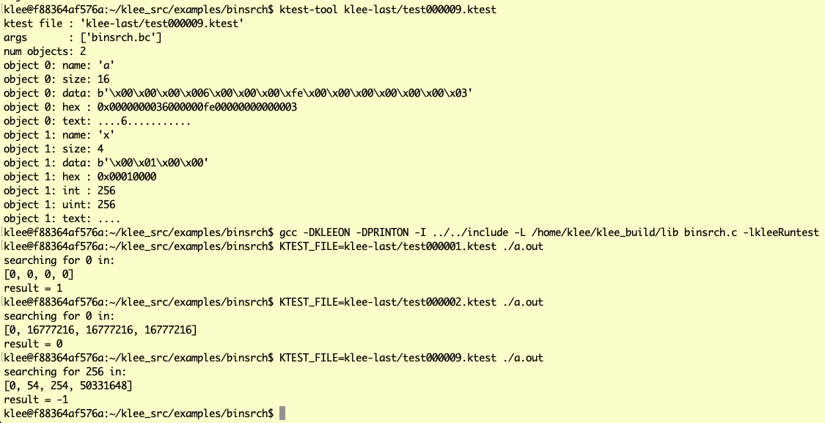
Demo-2 Binary Search Looks OK. Closer to shipping. What was achieved? * tests that cover every path * default C-level checks such as array out of bounds, null de reference i.e. FEWER BUGS

Slide 23
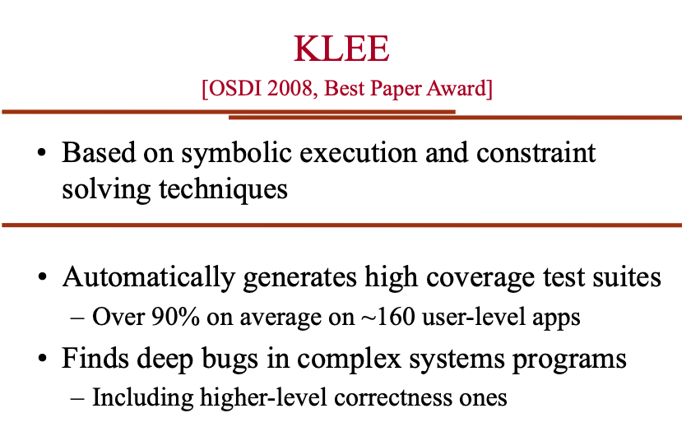
What does KLEE do? (Cadar’s slides)

Slide 24
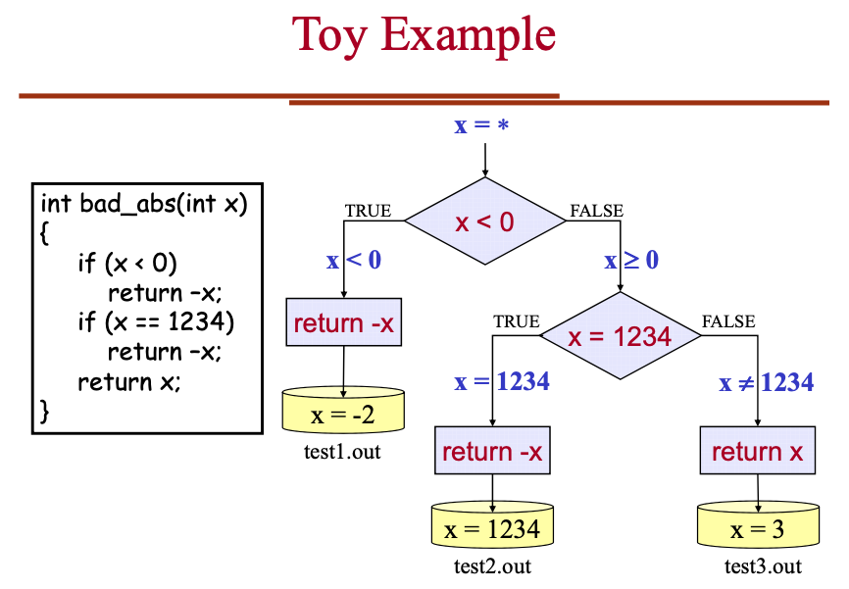
How does KLEE work? (Cadar’s slides)

Slide 25
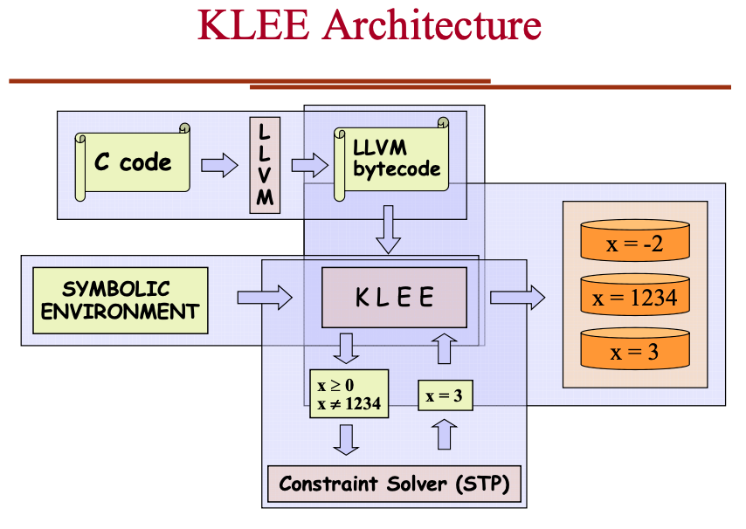
How does KLEE work? (Cadar’s slides)

Slide 26
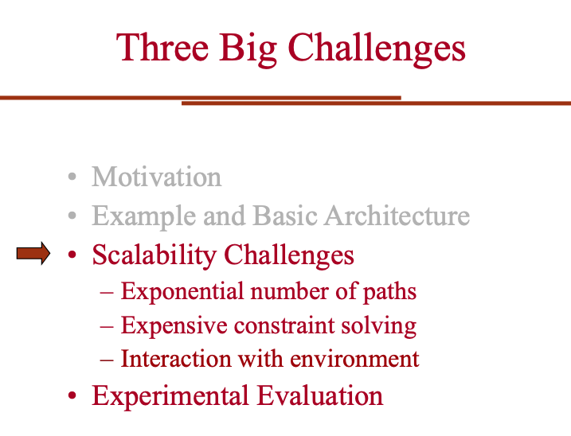
Engineering KLEE to be efficient (Cadar)

Slide 27

How good is KLEE (Dr. Peng Li’s slides)

Slide 28
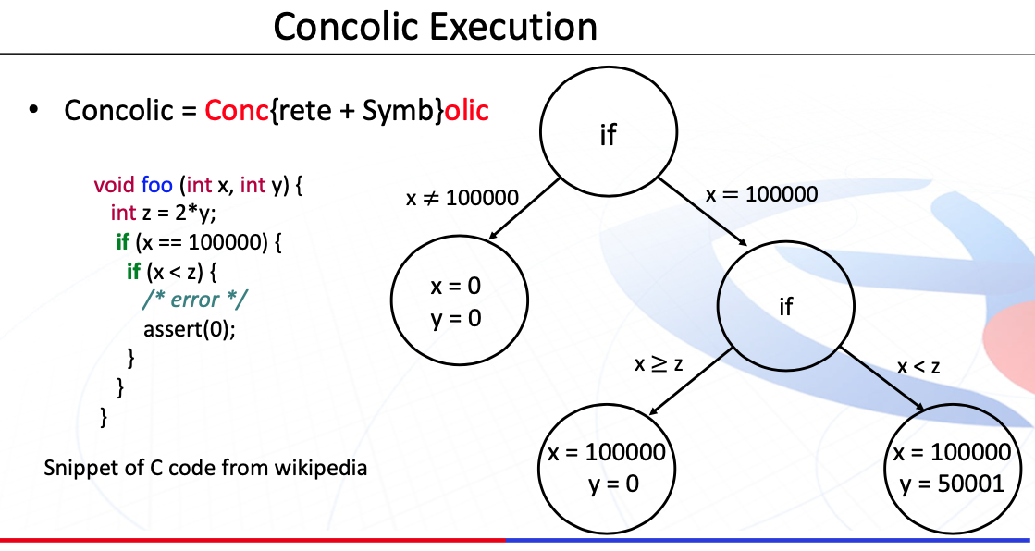
How good is KLEE (Dr. Peng Li’s slides)

Slide 29
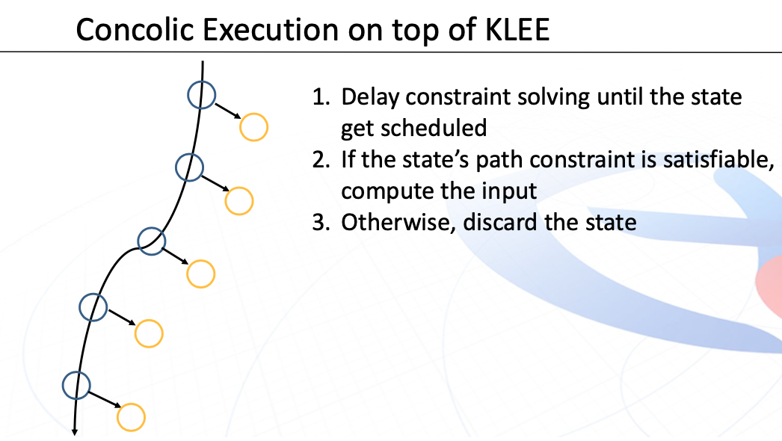
How good is KLEE (Dr. Peng Li’s slides)

Slide 30
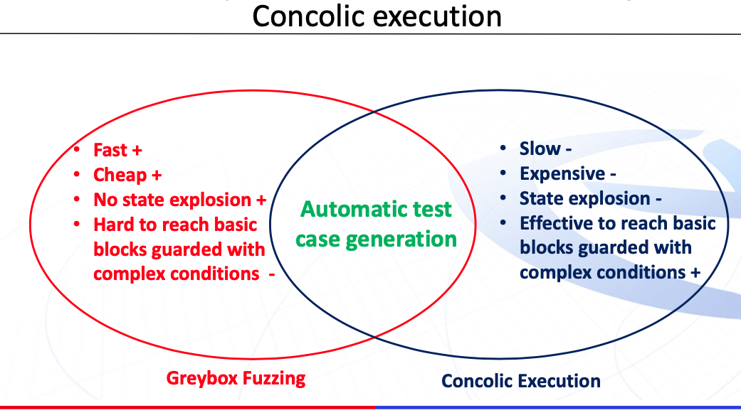
How good is KLEE (Dr. Peng Li’s slides)

Slide 31
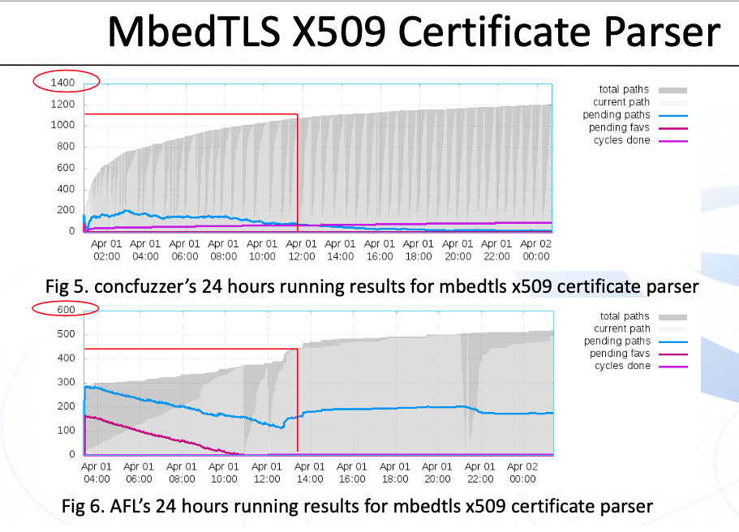
How good is KLEE (Dr. Peng Li’s slides)

Slide 32
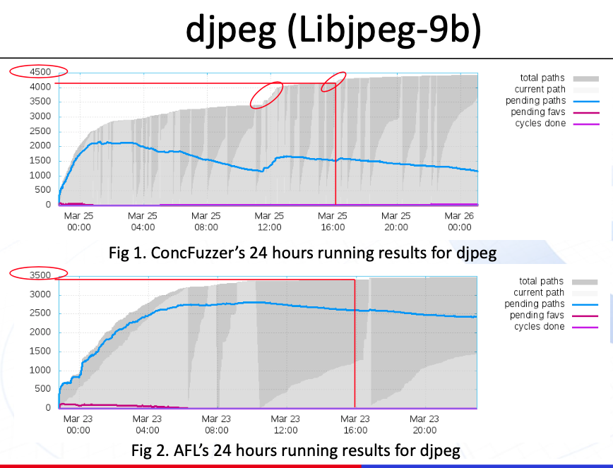
How good is KLEE (Dr. Peng Li’s slides)

Slide 33
Dr. Guodong Li’s and Dr. Peng Li’s FANTASTIC work on GKLEE follows See also Guodong’s work on PUG on the FSE 2010 publication site! It was followed by GPUVerify, another fantastic verifier from Alastair Donaldson’s groups at Imperial College, London

Slide 34
Summary
This is a huge field now – symbolic execution
You get to study this in projects
Even the MSR python Dyn Symb Executor – good project!

Slide 35
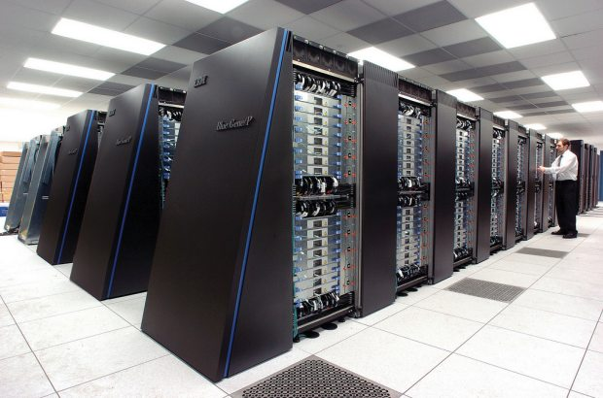
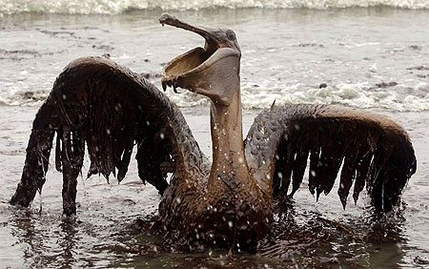
Correctness is central to Energy-Efficient Computing
The more performance per watt
we can obtain (e.g. TeraFlop in 30W,
Exaflop in 25 MW) … that is $25 Million
In electricity costs alone !!
… the less we need to depend on
dirty fuels,
… the faster we can innovate in
science and engineering
Intrepid supercomputer (Image courtesy of Argonne)
pogoprinciple.wordpress.com

Slide 36
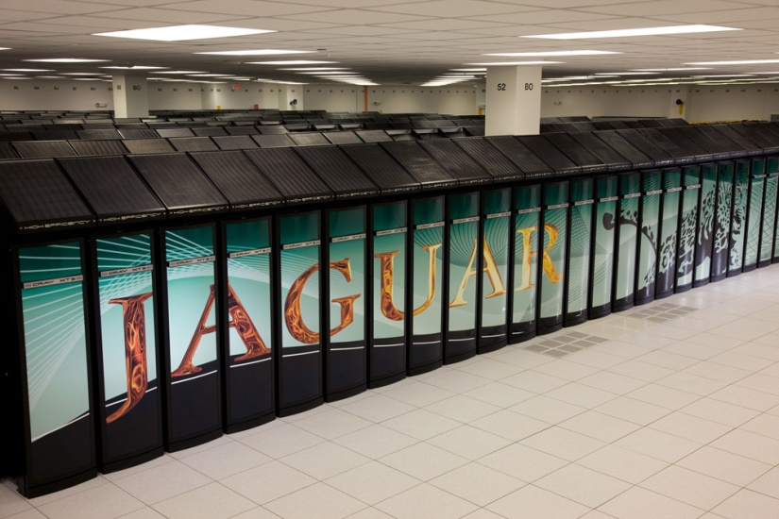
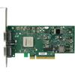
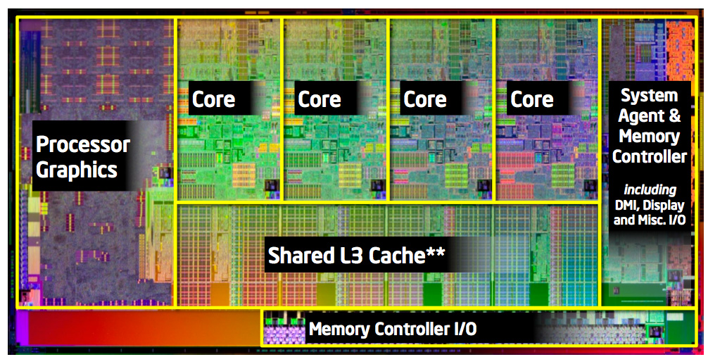
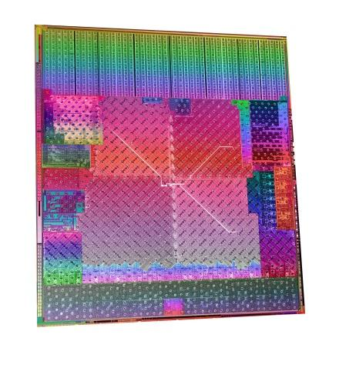
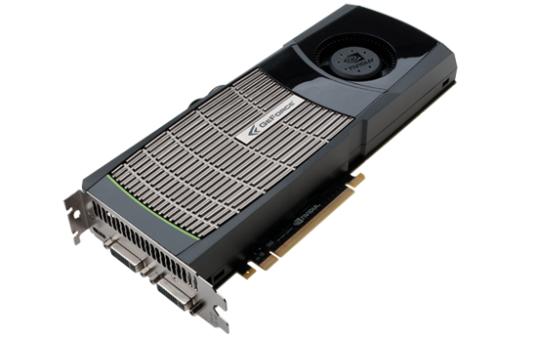
Emerging Heterogeneous Parallel Systems, and Role of Formal Methods in them
Problem Solving Environment based
User Applications
(1) Formal
Methods at the User Application Level
Problem-Solving
Environments
e.g. Uintah, Charm++, ADLB
High Performance
MPI Libraries
(2) Formal
Dynamic Methods for MPI
Concurrent
Data Structures
Infiniband style interconnect
(3) Formal
Analysis for CUDA Programs
Sandybridge (courtesy anandtech.com)
AMD Fusion APU
Geoforce GTX 480 (Nvidia)

Slide 37
Why conventional testing is inadequate
Exponential number of paths;
the bug may be deeply hidden
Exponential number of schedules; the bug may be triggered only by
one particular interleaving
Must be lucky
to schedule
threads in
this manner!
E1
…
E2
…
…
Must be lucky
to force such
“bad paths”!
En
Some bad interaction, such as
a data race may depend on
the schedule…
…

Slide 38
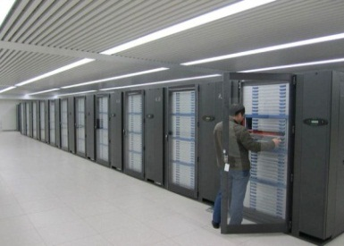
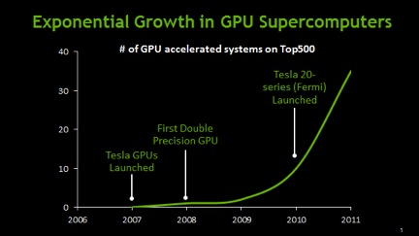


GPU-based Computing
About 40 of the top 500 machines were (in 2012) GPU-based
Personal supercomputers used for scientific research (biology, physics, …) increasingly based on GPUs
(courtesy of Nvidia,
www.engadget.com)
(courtesy of AMD)
(courtesy of Nvidia)
38

Slide 39
GKLEE (see PPoPP 2012)
__input__ int *values = (int *)malloc(sizeof(int) * NUM);
klee_make_symbolic(values, sizeof(int)*NUM, "values");
int *dvalues;
cudaMalloc((void **)&dvalues, sizeof(int) * NUM);
cudaMemcpy(dvalues, values, sizeof(int) * NUM, cudaMemcpyHostToDevice);
BitonicKernel <<< … >>> (dvalues);
Deadlocks
Data races
Concrete test inputs
Bank conflicts
Warp divergences
Non-coalesced
Test Cases
Provide high coverage
Can be run on HW
C++ CUDA Programs with Symbolic Variable Declarations
Error
Monitors
LLVM-GCC
LLVM byte-code instructions
Symbolic
Analyzer and
Scheduler

Slide 40
Our Formal Verification of CUDA builds on top of Sequential Program Verification by KLEE [OSDI ‘08]
#include "stdio.h"
#include "cutil.h"
#include "string.h"
#include "klee.h"
#define STRLEN 5
int main(){
char item;
char str[STRLEN];
int lo=0;
int hi;
int mid, found=0;
// printf("Please give char to be searched: \n");
// scanf("%c", &item);
klee_make_symbolic(&item, sizeof(item), "item");
// printf("Please give string within which to search: \n");
// scanf("%s", str);
klee_make_symbolic(str, sizeof(str), "str");
klee_assume(str[0] <= str[1]);
klee_assume(str[1] <= str[2]);
klee_assume(str[2] <= str[3]);
klee_assume(str[3] <= str[4]);
str[4] = '\0';
hi= 4; //strlen(str)-1; // strlen ignores null at the end of string
// hi points to last char in a 0 based array
while(!found && lo <= hi) {
mid = (lo+hi)/2;
if (item == str[mid])
{ printf("*");
found = 1; }
else
if (item < str[mid])
{ hi = mid-1;
printf("L"); }
else
{ lo = mid+1;
printf("H"); }
}
if (found) printf("found\n");//printf("\nitem %c found at posn %d\n", item, mid);
else printf("not found\n");//printf("\nitem %c not in str %s\n", item, str);
return found;
}
A simple Binary Search being prepared for formal symbolic analysis
This will force path coverage !!

Slide 41
Concurrency errors

Slide 42
Example: Increment Array Elements
Increment N-element array A by scalar b
tid 0 1 …
A
A[0]+b
A[1]+b
...
t0
t1
__global__ void inc_gpu(int*A, int b, intN) {
int idx = blockIdx.x * blockDim.x + threadIdx.x;
if (idx < 64) {
A[idx] = A[idx] + b;
}
42

Slide 43
Data Races in GPU Programs
The usual definition of a race:
“Two accesses, one of which is a write, that occur without
a happens-before edge between them.”
In GPUs, the happens-before is provided by
Barriers ( _syncthreads() )
Atomics
Write(a)
Write(a)
Write(a)
Read(a)

Slide 44
Illustration of Race
Increment N-element vector A by scalar b
tid 0 1 63
A
...
t0:
read A[63]
__global__ void inc_gpu(int*A, int b, int N) {
int idx = blockIdx.x * blockDim.x + threadIdx.x;
if (idx < 64) {
A[idx] = A[(idx – 1 + 64) % 64] + b;
}
t63:
write A[63]
RACE!
t63
t0
44

Slide 45
Porting Race: A Race-type Identified by us
Some hardware platforms may evaluate “then” before “else” – others may reverse this order
If we have a divergent warp where
a variable is READ in one path
and WRITTEN in another path,
then depending on the execution
order, the READ may be before/after
the WRITE

Slide 46
Example of Porting Race
#include <stdio.h>
#define NUM 32
__shared__ int v[NUM];
__global__ void PortingRace() {
if (threadIdx.x % 2) {
v[threadIdx.x] = v[ (NUM + threadIdx.x - 1) % NUM ] + 1; // W:even; R:odd
}
else {
v[threadIdx.x] = v[ (NUM + threadIdx.x + 1) % NUM ] - 1; // W:odd; R:even
}
}
int main() {
PortingRace<<<1,NUM>>>();
return 0;
}

Slide 47
CUDA-based GPU Programming Basics
A simple dialect of C++ with CUDA directives
Synchronization within Block through Barriers
(__syncthread())
Threads within block scheduled in warps
Don’t rely on warps for correctness!
Device Global Memory (shared between blocks) - Slowest
Block (Shared Memory) - Faster
Block (Shared Memory) - Faster
T0 (private Memory) - Fastest
T1 (private Memory) - Fastest
T2 (private Memory) - Fastest
T3 (private Memory) - Fastest
T0 (private Memory) - Fastest
T1 (private Memory) - Fastest
T2 (private Memory) - Fastest
T3 (private Memory) - Fastest
47

Slide 48
Conventional GPU Debuggers are Inadequate
Based on platform testing
Full generality of executions not reflected
Hard to cause races (input selection)
Hard to observe races
vector-clock based solutions that run on GPUs exist
(last time we checked) only for shared memory races

Slide 49
Some of the GPU Program Bugs
Data races
Cause unpredictable outputs
Cause compilers to misbehave
Incorrectly used synchronizations
Syncthreads not used with textual barriers
Syncthreads causing deadlocks
Misunderstood memory consistency models
When updates are visible across threads
Incorrectly used atomics (synchronization)
Due to incorrect synchronization, invariants get broken
Erroneous computational results – esp. with floating-point
Due to unpredictable computational order, results may diverge

Slide 50
Why are Data Races Highly Problematic?
Testing is seldom conclusive
Must infer a race indirectly (e.g. corrupted results)
Races manifest when code is ported or optimized
Scheduling can change
Data races make compiled results suspect
Compilers optimize assuming the absence of races in the most general setting

Slide 51
Synchronization Primitives in CUDA
Device Global Memory (shared between blocks) - Slowest
Block (Shared Memory) - Faster
Block (Shared Memory) - Faster
T0 (private Memory) - Fastest
T1 (private Memory) - Fastest
T2 (private Memory) - Fastest
T3 (private Memory) - Fastest
T0 (private Memory) - Fastest
T1 (private Memory) - Fastest
T2 (private Memory) - Fastest
T3 (private Memory) - Fastest
__kernel__ void deadlock() {
if (threadIdx.x > 0) {
v[threadIdx.x]++;
}
else {
v[threadIdx.x]--;
}
__syncthreads(); // Barrier
}
51

Slide 52
Synchronization Primitives in CUDA
Device Global Memory (shared between blocks) - Slowest
Block (Shared Memory) - Faster
Block (Shared Memory) - Faster
T0 (private Memory) - Fastest
T1 (private Memory) - Fastest
T2 (private Memory) - Fastest
T3 (private Memory) - Fastest
T0 (private Memory) - Fastest
T1 (private Memory) - Fastest
T2 (private Memory) - Fastest
T3 (private Memory) - Fastest
__kernel__ void deadlock() {
if (threadIdx.x > 0) {
v[threadIdx.x]++;
}
else {
v[threadIdx.x]--;
}
__syncthreads(); // Barrier
}
Threads within a block can
synchronize using __syncthreads().
(This call synchronizes threads, also gives
the effect of the stronger fence “thread_fence”.)
52

Slide 53
Synchronization Primitives in CUDA
Device Global Memory (shared between blocks) - Slowest
Block (Shared Memory) - Faster
Block (Shared Memory) - Faster
T0 (private Memory) - Fastest
T1 (private Memory) - Fastest
T2 (private Memory) - Fastest
T3 (private Memory) - Fastest
T0 (private Memory) - Fastest
T1 (private Memory) - Fastest
T2 (private Memory) - Fastest
T3 (private Memory) - Fastest
__kernel__ void deadlock() {
if (threadIdx.x > 0) {
v[threadIdx.x]++;
}
else {
v[threadIdx.x]--;
}
__syncthreads(); // Barrier
}
For synchronization
across blocks, we must
use one of the CUDA
Atomics (Zvonimir will
present our NFM’13 work)
Threads within a block can
synchronize using __syncthreads().
(This call synchronizes threads, also gives
the effect of the stronger fence “thread_fence”.)
53

Slide 54
Deadlocks caused by misused __syncthreads()
Cause a “hang” or unspecified behavior
__SyncThreads()

Slide 55
Illustration of “Deadlock” (conceptual deadlock; behavior is really undefined)
__global__ void kernelName (args) {
int idx = blockIdx.x * blockDim.x + threadIdx.x;
if (idx == 3) {
….
__syncthreads();
}
idx < N
idx ≥ N
__kernel__ void deadlock() {
if (threadIdx.x > 0) {
v[threadIdx.x]++;
__syncthreads();
}
else {
v[threadIdx.x]--;
__syncthreads();
}
}
Suffers from Textually
Non-aligned Barriers
(example Deadlock1.C)
55

Slide 56
Warp Divergence
__global__ void kernelName (args) {
int idx = blockIdx.x * blockDim.x + threadIdx.x;
if ( odd(idx) ) {
<Statements1>
} else {
<Statements2>
}
This is a performance bug – but can be
detected through formal symbolic analysis

Slide 57

Memory-bank Conflicts
Happen when two threads generate addresses that fall into the same memory bank
Memory Banks
This is a performance bug – but can be
detected through formal symbolic analysis

Slide 58
Non-coalesced Memory Fetches
Happen when threads generate global memory addresses that do not fully utilize the bus
Memory
This is a performance bug – but can be
detected through formal symbolic analysis
(10 x more severe than bank conflicts)

Slide 59
Two approaches to modeling
Through interleaving
Followed in most works
Through lock-step synchronous execution
Pioneered in GPUVerify

Slide 60

How bad is the interleaving problem?
It is like shuffling decks of cards
> 6 * 10^14 interleavings for 5 threads with 5 instructions
60

Slide 61
Avoiding Interleaving Explosion

Slide 62
Solution to the interleaving problem: Find representative interleavings
For Example:
If the green dots are
local thread actions,
then
all schedules
that arrive
at the “cut line”
are equivalent!

Slide 63
Solution to the interleaving problem: Find representative interleavings
For Example:
If the green dots are
local thread actions,
then
all schedules
that arrive
at the “cut line”
are equivalent!

Slide 64
Solution to the interleaving problem: Find representative interleavings
For Example:
If the green dots are
local thread actions,
then
all schedules
that arrive
at the “cut line”
are equivalent!

Slide 65
GKLEE Avoids Examining Exp. Schedules !!
Instead of considering all
Schedules and
All Potential Races…
65

Slide 66
GKLEE Avoids Examining Exp. Schedules !!
Consider JUST THIS SINGLE
CANONICAL SCHEDULE !!
Folk Theorem (proved in our paper):
“We will find A RACE
If there is ANY race” !!
Instead of considering all
Schedules and
All Potential Races…
66

Slide 67
Why does a sequential run suffice?
If the red pair is the only
race, then it occurs after
the cut-line
So all the ways to reach
the cut-line are
EQUIVALENT !!
67

Slide 68
So this sequential run is equivalent too.
You my complain saying:
“But, the sequential run
Inches Past the Cutline !!”
But hey, you told me that
this is the ONLY race!
If there were some other
race encountered before,
then that will be caught.
… there is a “first race”
and that will be caught !
68

Slide 69
Concolic execution helps find witnesses to data races
__global__ void histogram64Kernel(unsigned *d_Result, unsigned *d_Data, int dataN) {
const int threadPos = ((threadIdx.x & (~63)) >> 0)
| ((threadIdx.x & 15) << 2)
| ((threadIdx.x & 48) >> 4);
...
__syncthreads();
for (int pos = IMUL(blockIdx.x, blockDim.x) + threadIdx.x; pos < dataN;
pos += IMUL(blockDim.x, gridDim.x)) {
unsigned data4 = d_Data[pos];
...
addData64(s_Hist, threadPos, (data4 >> 26) & 0x3FU); }
__syncthreads(); ...
}
inline void addData64(unsigned char *s_Hist, int threadPos, unsigned int data)
{ s_Hist[ threadPos + IMUL(data, THREAD_N) ]++; }
“GKLEE: Is there a Race ?”
69

Slide 70
Concolic execution helps find witnesses to data races
__global__ void histogram64Kernel(unsigned *d_Result, unsigned *d_Data, int dataN) {
const int threadPos = ((threadIdx.x & (~63)) >> 0)
| ((threadIdx.x & 15) << 2)
| ((threadIdx.x & 48) >> 4);
...
__syncthreads();
for (int pos = IMUL(blockIdx.x, blockDim.x) + threadIdx.x; pos < dataN;
pos += IMUL(blockDim.x, gridDim.x)) {
unsigned data4 = d_Data[pos];
...
addData64(s_Hist, threadPos, (data4 >> 26) & 0x3FU); }
__syncthreads(); ...
}
inline void addData64(unsigned char *s_Hist, int threadPos, unsigned int data)
{ s_Hist[ threadPos + IMUL(data, THREAD_N) ]++; }
Threads 5 and and 13 have a WW race
when d_Data[5] = 0x04040404 and d_Data[13] = 0.
GKLEE
70

Slide 71
Summary
This is a huge field now – symbolic execution
You get to study this in projects
Even the MSR python Dyn Symb Executor – good project!

